Slide 1

Food Delivery
Marketplace
UPLIFT MODELING &
INTERFERENCE DETECTION
10,000
Customers
IN TWO-SIDED MARKETPLACES
50 Neighborhoods
X-Learner · T-Learner · S-Learner
Optimising Marketing Spend with Causal ML
$140K
735%
70%
Annual Savings
Uplift ROI
Cost Reduction
Executive Summary | 2026
By: Ibrahim Musbaudeen

Slide 2
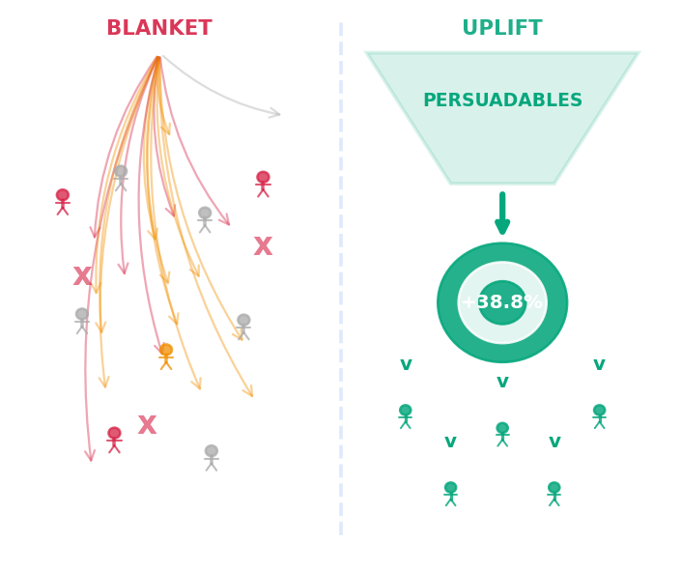
THE CHALLENGE & OUR APPROACH
Moving beyond 'who will buy' to 'who will buy BECAUSE of the promotion'
❌ THE OLD WAY — BLANKET TARGETING
✅ THE NEW WAY — UPLIFT TARGETING
$50,000
$15,000
spent per campaign on all 10,000 customers
spent — only on the right 3,000 customers
Sure Things
Persuadables
get coupons they didn't need — pure margin loss
identified & targeted: 38.8% uplift effect
Sleeping Dogs
Sleeping Dogs
receive coupons that REDUCE their conversion
excluded — protecting revenue & brand
146% ROI
735% ROI
despite massive overspend — highly inefficient
5× better than blanket — same revenue, 70% less cost
No signal
Causal ML
on WHICH customers actually respond to promotions
X-Learner meta-learner identifies who RESPONDS
© Uplift Modeling Project

Slide 3
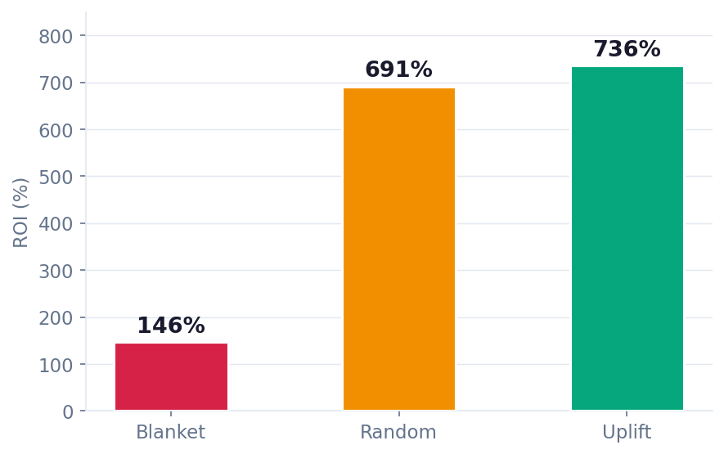
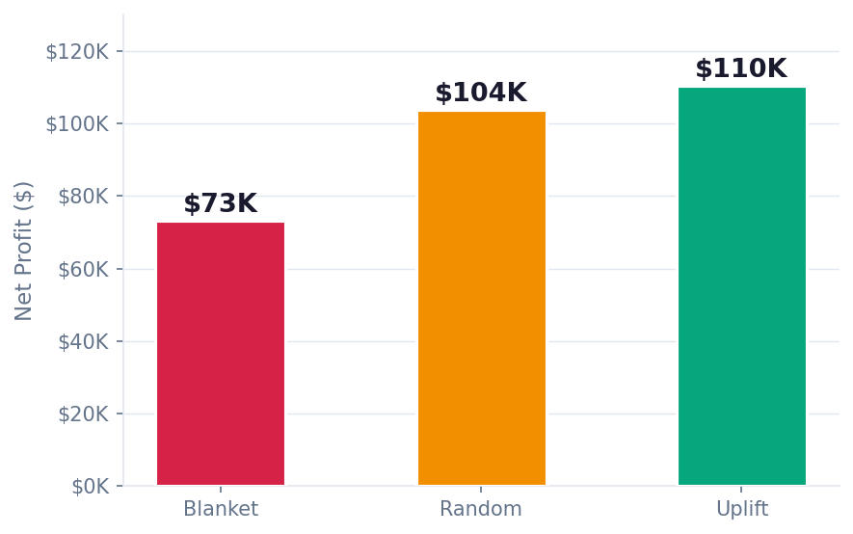
ROI & PROFIT COMPARISON
Corrected analysis: revenue counted from all customers — only cost differs by strategy
BLANKET
RANDOM
UPLIFT
$73K
$104K
$110K
Net Profit
Net Profit
Net Profit
$50K Cost | 10,000 targeted
$15K Cost | 3,000 targeted
$15K Cost | 3,000 targeted ✓
ROI (%) by Strategy
Net Profit ($) by Strategy
© Uplift Modeling Project

Slide 4
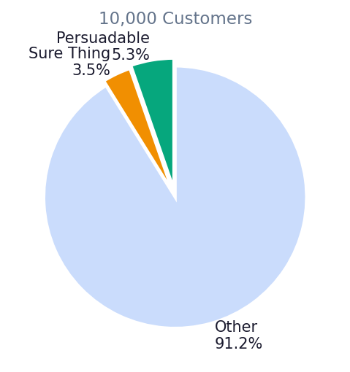
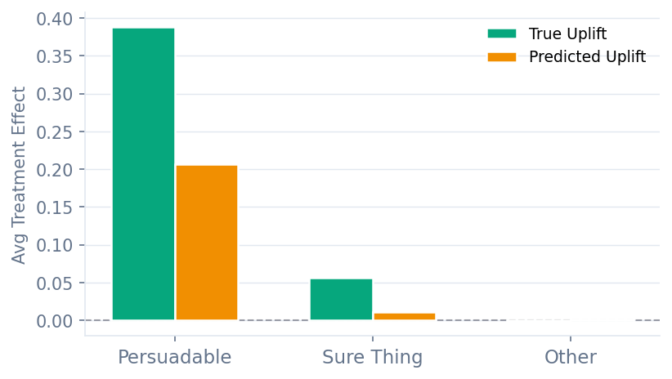
CUSTOMER SEGMENTATION
Understanding WHO responds to promotions — and who to avoid
PERSUADABLE
SURE THING
OTHER / LOST CAUSE
5.3% | 531 customers
+38.8% uplift
3.5% | 351 customers
+5.7% uplift
91.2% | 9,118 customers
-0.2% uplift
Medium recency, engaged but not premium. Coupons CAUSE conversions. Primary target.
High recency, high engagement. Will buy anyway. Coupon wastes margin — low priority.
Majority segment. Negligible or slightly negative response. Coupon spend not justified.
✓ TARGET
⚠ LOW PRIORITY
✗ EXCLUDE
Segment Distribution
True vs. Predicted Uplift by Segment
© Uplift Modeling Project

Slide 5
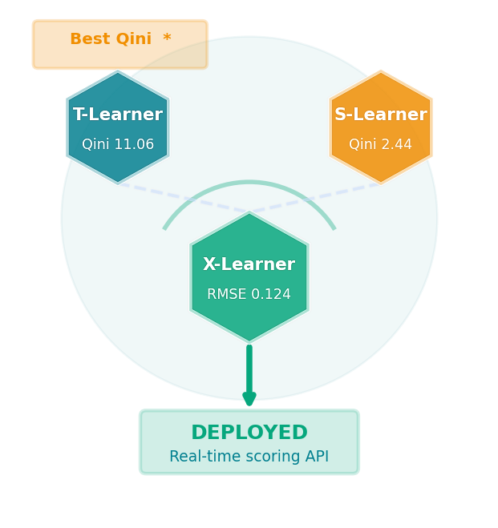
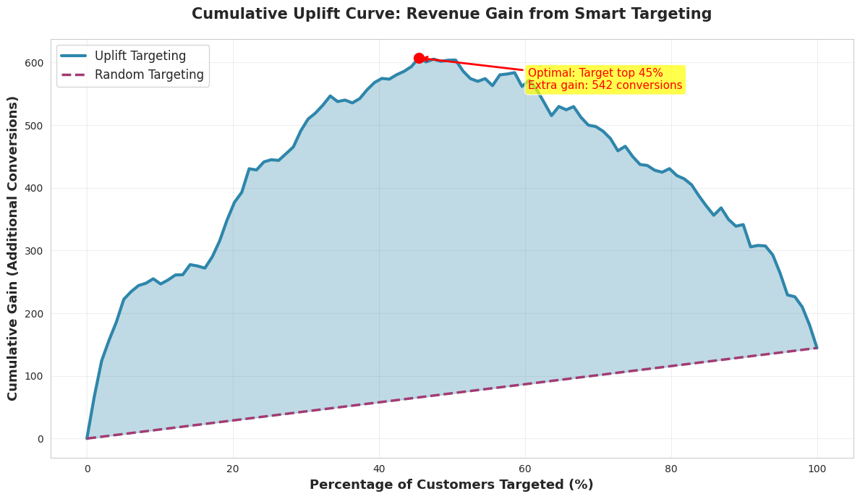
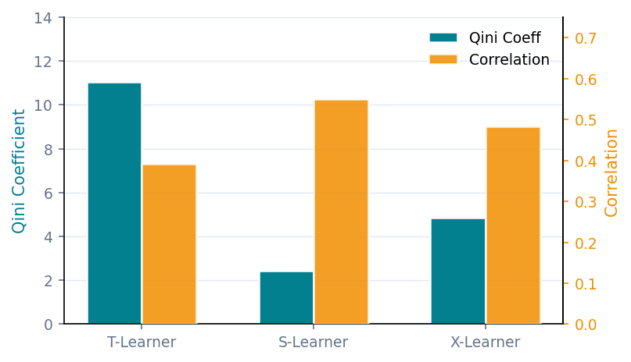
MODEL PERFORMANCE
Three meta-learners evaluated — T-Learner achieves best Qini; X-Learner used for deployment
Model
RMSE
MAE
Correlation
Qini ↑
T-Learner
0.1427
0.1130
0.391
11.06 🏆
S-Learner
0.1267
0.1004
0.549
2.44
X-Learner
0.1242
0.1003
0.483
4.87
★ X-Learner selected for deployment — best RMSE/MAE; T-Learner leads on Qini ranking metric
Cumulative Uplift Curve — Smart vs Random Targeting
Model Comparison: Qini & Correlation
© Uplift Modeling Project

Slide 6
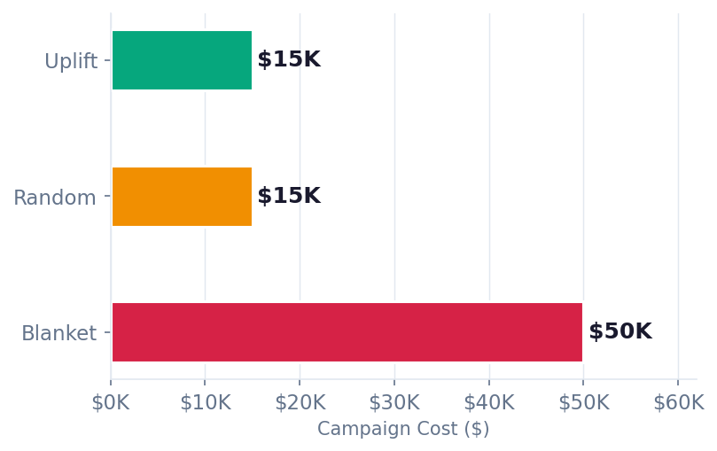
BUSINESS IMPACT & FINANCIAL SUMMARY
Quarterly campaign analysis — uplift targeting vs. blanket coupon distribution
$35,000
$110,326
735%
$140,000
5.02×
Cost Saved
Per Campaign
Profit
Uplift Strategy
ROI
Uplift Strategy
Annual
Savings
ROI
Multiplier vs Blanket
Campaign Cost Comparison
📋 RECOMMENDATIONS
IMMEDIATE
Deploy uplift model to target top 30% by predicted CATE
Implement real-time scoring API for marketing automation
A/B test vs current approach — est. $35K/quarter savings
FUTURE
Extend model to free delivery & loyalty point incentives
Build dynamic coupon value optimisation engine
Create lookalike models for customer acquisition
© Uplift Modeling Project

Slide 7
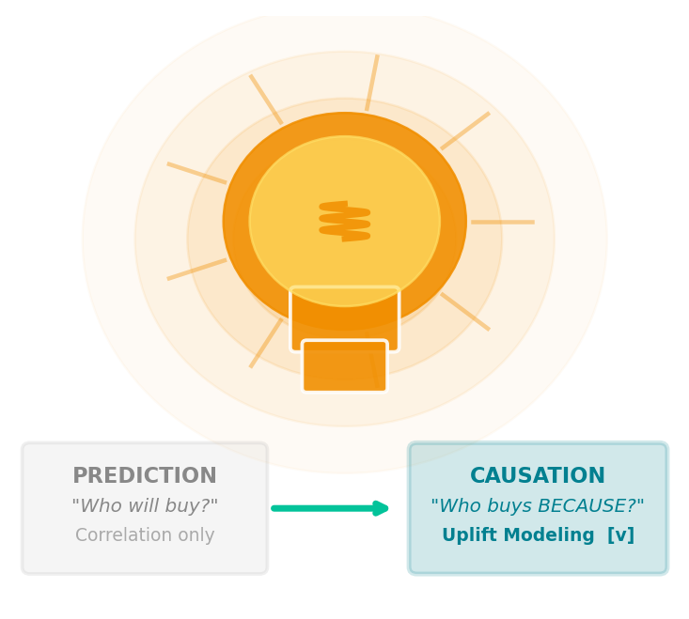
KEY TAKEAWAYS
From Prediction to Causation.
That's what separates good data science from great.
01
Uplift modeling identifies WHO responds to promotions — not just who buys
02
70% cost reduction achieved by targeting only 30% of customers
03
Sleeping Dogs & Sure Things excluded — protecting margin & brand
04
X-Learner meta-learner deployed for counterfactual CATE estimation
Thank You
Questions & Discussion Welcome
Uplift Modeling & Interference Detection | Executive Summary | 2026

